Slide 1
Microbiology of cardiovascular disease
By Mamita Rai Gurung

Slide 2
Introduction
The essential components of the human cardiovascular system are heart, blood and blood vessel.
The infectious diseases that affect the heart are pericarditis, myocarditis, endocarditis and rheumatic heart disease.
Among these, pericarditis, myocarditis, endocarditis are directly caused by microorganisms that infect the pericardial space, the heart myocytes, and the endothelium that lines the heart valves, respectively whereas , rheumatic heart disease, is NOT due to an infection of the heart, but rather to an autoimmune reaction of the host to the heart and its valves following an antecedent bacterial infection of the pharynx caused by Streptococcus pyogenes.
Viruses are the most common cause of pericarditis and myocarditis; endocarditis is usually caused by bacteria.

Slide 3
Bacteremia
Bacteremia is the presence of viable bacteria in the circulating blood without multiplication, which is often silent and transient. Serious sequelae are increasingly uncommon.
Particularly caused by Streptococcus pneumoniae and Salmonella, However, serious bacterial infections occur, including pneumonia, septic arthritis, brain abscesses, osteomyelitis, cellulitis, meningitis, and sepsis, possibly resulting in death.
Escherichia coli most common pathogen found in neonatal and infant bacteremia

Slide 4
Signs and symptoms
Bacteremia may cause no symptoms and resolve without treatment, or it may produce fever and other symptoms of infection. In some cases, bacteremia leads to septic shock, a potentially life-threatening condition.
Some of the symptoms
Chills, malaise, abdominal pain, nausea
Vomiting, diarrhea, anxiety, shortness of breath,
confusion
Notes:
eptic shock is a serious medical condition that occurs when sepsis, which is organ injury or damage in response to infection, leads to dangerously low blood pressure

Slide 5
Common immediate causes of bacteremia include:
drainage of an abscess
urinary tract infection,
decubitus ulcers (pressure sores)
intravenous procedures using unsterilized needles, including IV drug use prolonged IV needle placement
use of ostomy tubes and colostomy (surgically creating an articifical opening into the colon).

Slide 6
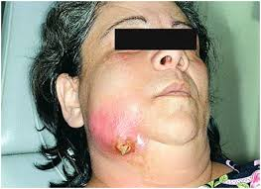
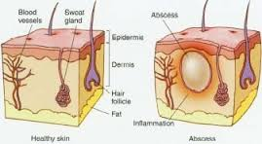
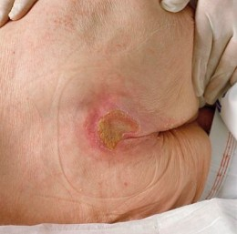
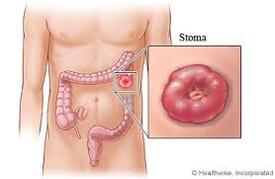

Slide 7
Septicaemia
Septicaemia is a condition in which bacteria circulate and actively multiply with the production of toxin.
Septicemia is a serious, life-threatening infection that gets worse very quickly. It can arise from infections throughout the body, including infections in the lungs, abdomen, and urinary tract. It may come before or at the same time as infections of the:
Bone-osteomyelitis
Central nervous system-meningitis
Heart-endocarditis
Other tissues

Slide 8
Signs and symptoms
Septicemia can begin with:
Chills
High fever
Rapid breathing
Rapid heart rate
The person looks very ill.
The symptoms quickly progress to:
Confusion or other changes in mental status
Red spots on the skin
There may be decreased or no urine output.

Slide 9
 | Bacteremia | Septicemia
1. | Bacteremia is the simple presence of bacteria in the blood. | Septicemia is the presence and multiplication of bacteria in the blood.
2. | Bacteremia is not as dangerous as Septicemia. | Septicemia is a potentially life-threatening infection.
3. | Less amount of bacteria are present in blood. | Large amounts of bacteria are present in the blood.
4. | This may occur through a wound or infection, or through a surgical procedure or injection. | It can arise from infections throughout the body, including infections in the lungs, abdomen, and urinary tract.
5. | Toxins are not produced. | Toxins may be produced by bacteria.
6. | Bacteremia usually causes no symptoms or it may produce mild fever. | It shows symptoms like chills, fever, prostration, very fast respiration and/or heart rate.
Notes:
Prostration A condition in which a person is so tired or weak that he or she is unable to do anything.

Slide 10
Contd………………..
7. | It can resolve without treatment. | Untreated septicemia can quickly progress to sepsis.
8. | Rapidly removed from the bloodstream by the immune system. | Antibiotics will be used to treat the bacterial infection that is causing septicemia.
9. | Caused by Staphylococcus, Streptococcus, Pseudomonas, Haemophilus, E. coli, dental procedures, herpes (including herpetic whitlow), urinary tract infections, peritonitis, Clostridium difficile colitis, intravenous drug use, and colorectal cancer. | Staphylococci, are thought to cause more than 50% of cases of sepsis. Other commonly implicated bacteria include Streptococcus pyogenes, Escherichia coli, Pseudomonas aeruginosa, Klebsiella species and even Candida spp.
Notes:
Sepsis is the body's extreme response to an infection. It is a life-threatening medical emergency.

Slide 11
Pericarditis
Pericarditis is an inflammation of the fibroserous sac enclosing the heart and has multiple infectious and noninfectious causes.
There are three different types of infectious pericarditis: viral pericarditis, purulent pericarditis (also called acute bacterial pericarditis), and chronic pericarditis (also called tuberculous pericarditis).
The etiological agents includes
Viral: Most commonly by Enteroviruses (i.e., coxsackieviruses A and B and echovirus). Less common causes of viral pericarditis include herpes viruses, adenoviruses, influenza virus, human immunodeficiency virus (HIV), and mumps virus.
Bacterial: Staphylococcus aureus and Streptococcus pneumoniae, Mycobacterium tuberculosis
Fungal: Candida albicans

Slide 12
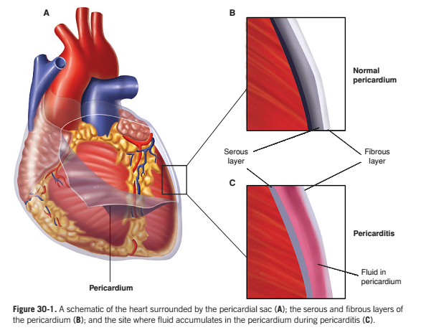

Slide 13
Myocarditis
Myocarditis is an infection of the myocardium or the myocytes of the heart. Viruses are the most common cause of myocarditis, and are ingested in fecally contaminated water or food. The viruses then enter the bloodstream and infect the heart myocytes.
The etiological agents includes;
- Viral: Enteroviruses, coxsackievirus B , herpes viruses, HIV, and mumps virus.
- Bacterial: Legionella, Chlamydia and Borrelia burgdorferi
- Fungal: Aspergillus fumigatus, Candida albicans, and Cryptococcus neoformans
- Parasites:Trypanosoma cruzi and Trichinella spiralis

Slide 14
Endocarditis
Endocarditis is an inflammation of the endothelium that lines the inside of the heart.
Certain areas of the endothelium are more likely to be affected in endocarditis, including the surfaces of the heart valves.
The etiological agents includes;

Slide 15
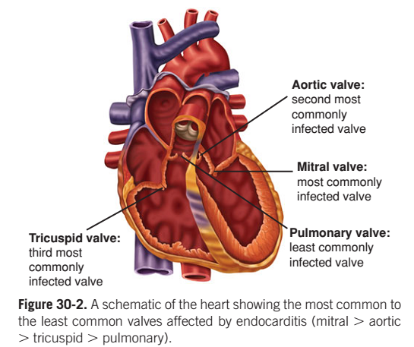
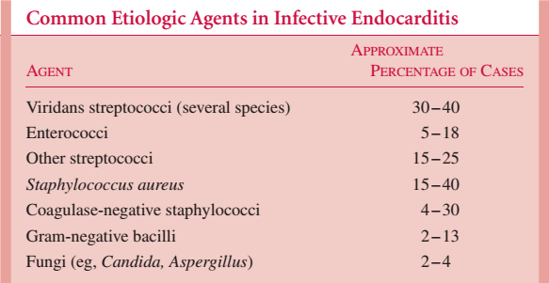
The etiological agents includes;

Slide 16
Lab diagnosis of endocarditis
Sample:Blood
Collection technique:Vein puncture
■Blood cultures -critical in determining the diagnosis of infective endocarditis. Infective endocarditis is associated with a constant low-level bacteremia. Three blood samples should be obtained over a 24-hours period. The diagnosis is confirmed if good bacterial growth from the blood samples is obtained and if damage to the heart valves is detected by transesophageal echocardiograph.
Media used for blood culture:-Blood Agar, Blood culture broth
Incubated at 37 degree celcius for 3 weeks. Presence of colonies –Identification procedure followed
■others
Transesophageal echocardiography -detecting valvular vegetations. It readily detects extravalvular extension of infection and can visualize valve perforations. Chest radiographs may demonstrate distinct round cannonball-like pulmonary emboli in right-sided endocarditis..

Slide 17
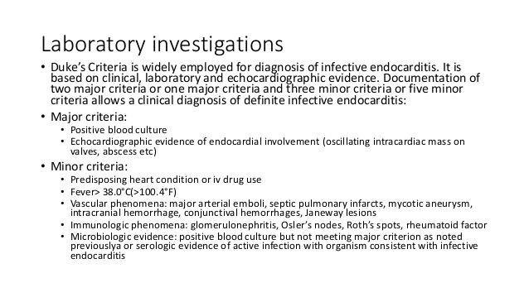

Slide 18
Total Count
Differential Count
ESR Value (Erythrocytes sediments rates)
C-Reactive Protein Test(CRP)-Latex agglutination method:50microlitre serum mixed with anti-CRP antibodies

Slide 19
Rheumatic fever and Rheumatic heart disease
Rheumatic fever also known as Acute rheumatic fever is an autoimmune response to the S pyogenes infection of the pharynx that causes damage to the heart, joints, central nervous system, skin, and subcutaneous tissues.
The heart is involved in about half of cases. Permanent damage to the heart valves, known as rheumatic heart disease (RHD),
Rheumatic heart disease is permanent damage to the heart following rheumatic fever. It can lead to heart failure and sometimes the need for cardiac surgery. Rheumatic heart disease is the most common form of heart disease in children in the world.

Slide 20
The causative agents
S pyogenes (group A Streptococcus) is the etiologic agent that induces autoimmune reactions that cause rheumatic fever and rheumatic heart disease.
Both diseases occur after a pharyngeal infection due to S pyogenes. Following pharyngitis caused by S pyogenes, the host’s immune system produces antibodies that react with bacterial antigens and certain host tissues (i.e., cross-reactive antibodies).

Slide 21
Contd...
The two bacterial factors that appear to be important in the development of pharyngitis, acute rheumatic fever and rheumatic heart disease are hyaluronic acid capsule and M protein.
The hyaluronic acid capsule protects the bacteria from phagocytosis; however, it is identical to the hyaluronic acid found in the host’s connective tissues. If antibodies are produced to the bacteria’s capsule, these antibodies can also cause damage in the host.
Similarly M protein is important in adherence to host epithelial cells, internalization in host cells, and avoidance of phagocytosis. M proteins are highly immunogenic so anti–M protein antibodies are produced which can cross react with heart tissue.

Slide 22
Contd........
Other streptococcal antigens structurally similar to host tissues include cell-wall polysaccharides (similar to glycoproteins in heart valves) and membrane antigens that share epitopes with the sarcolemma in striated muscle cells and smooth muscle.

Slide 23
Thank You

